Slide 1
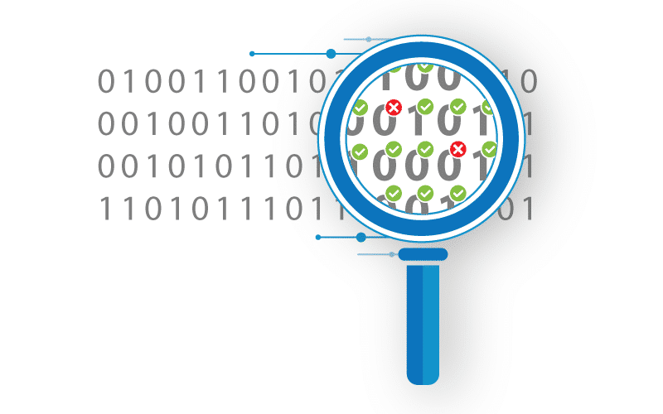

Insights for Impact
A Data Quality story from South Africa

Slide 2

Why data quality started
Multiple health authorities using multiple forms for collecting data
Paper-based systems made analysis difficult
Data was not used and therefore not noticed when missing
Notes:
Drakensberg municipality -example

Slide 3
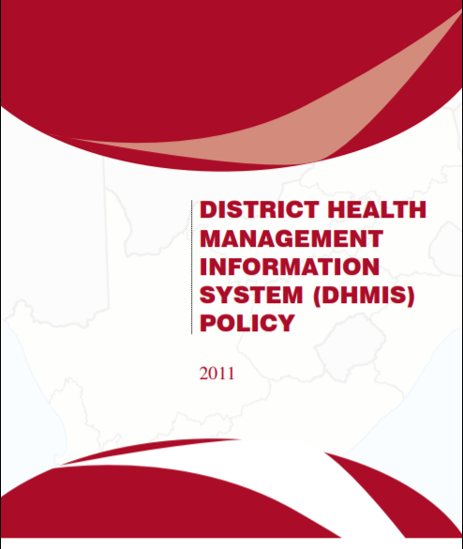
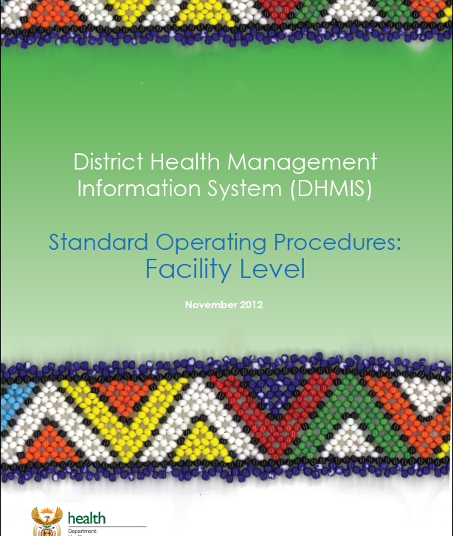
The Introduction of DHIS1
DHIS1 was Introduced and rolled out nationally between 1999-2000
It was a computerized database but not web-based (MS Access and pivot tables)
Data regression and interpolation features
Validation rules – absolute and statistical
Customized data sets per facility type – allowed analysis of data element reporting rates
Data extracted to standardized pivot tables using a DataMart for data analysis and reporting
To facilitate implementation
Minimum data set with standardized data collection tools
Development of HMIS policy and SOPs
Employment of Information staff in districts and provinces
On introduction of new forms, DQ checks were done within 3-4 months to ensure that definitions were understood
Extensive training on data quality and use of information
Pre-submission data validation using a standardized template
Data clean-up workshops before locking of data
Notes:
NIDS revised very 2 years – inputs from programme managers, reviewed by NHISSA with rigorous debate and signed off by Minister of Health
Explain pre-submission process

Slide 4

Updating to DHIS2
The introduction of DHIS2 was delayed because DHIS1.4 had great data quality features not available in DHIS2
Shortcomings in DHIS1.4 compelled the move to DHIS2
Updating standalone computers at every capturing point with latest build
Length of time for data to reach the National Department of Health

Slide 5

DQ strategies
Minimum data set
Daily data capturing (DDC) at service point level
Standardized public dashboards – 3 devoted to DQ
Applying legends to indicators – unlikely values colour-coded blue
HTML reports
Monitor timeliness and completeness prior to deadlines
Element reporting rate for community outreach services
Pre-submission reports – also serve as feedback to lower level
Monthly DQ report sent to National Department of Health
Rapid Internal Performance Data Audits to compare source data with values in DHIS

Slide 6

DQ measurements
Timeliness
Data sets assigned to the facility are completed by the 10th of the month
Completeness
Data sets assigned to the facility are completed by the 30th of the month
Programme completeness
The selected proxy data element for the programme is captured for facilities that are expected to report on it
Element reporting rate for community outreach
Missing and Outlier analysis – use the WHO app
Validation rule violations
Notes:
Explain the use of proxy DE for programme completeness – the absence of customized data sets to measure ERR
Missing and Outlier – pre-submission and monthly DQ report focus on the worst 15 for key data elements

Slide 7

DQ dashboards
Data quality
DDC monitoring
DQ monitoring
Used by managers at the lowest level of the hierarchy
Notes:
Show these using HISPLAND database

Slide 8
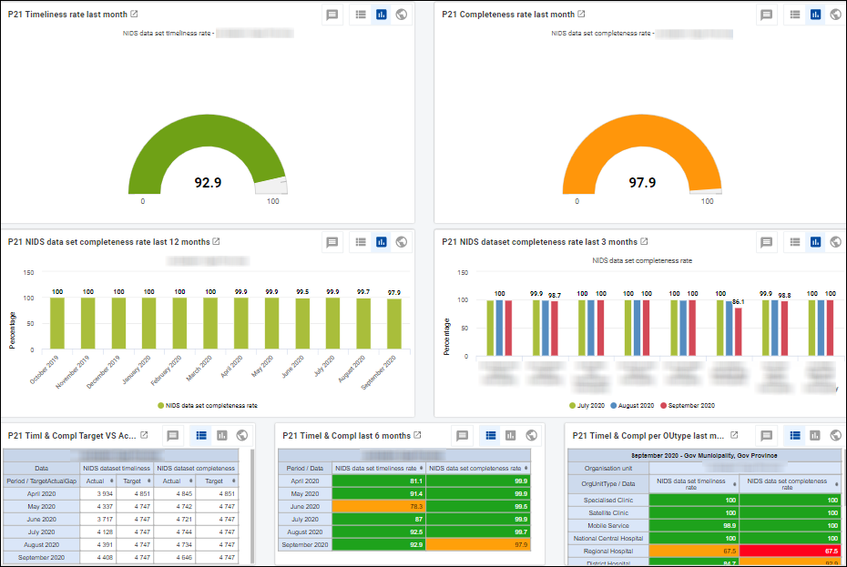
Timeliness and Completeness

Slide 9
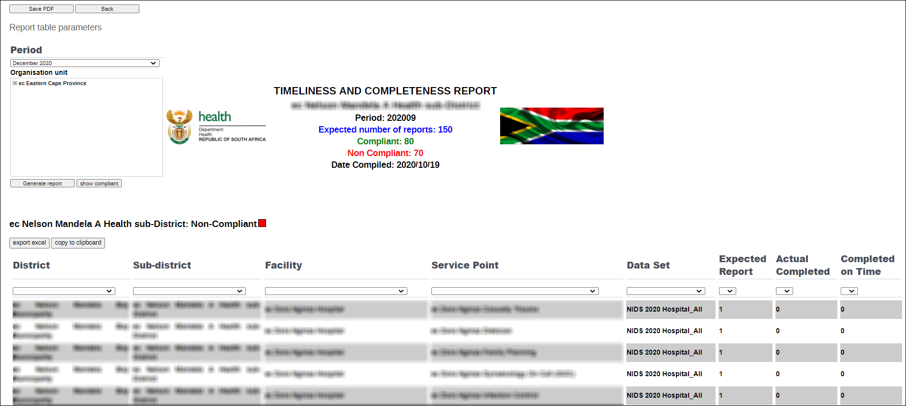
Timeliness and Completeness

Slide 10
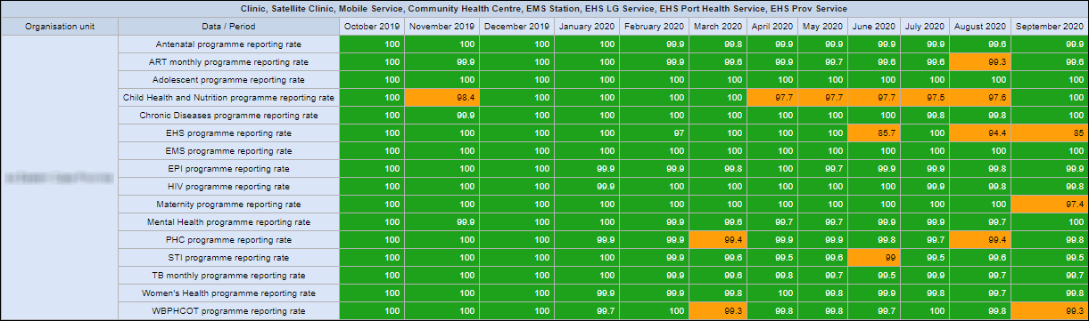
Program Reporting

Slide 11
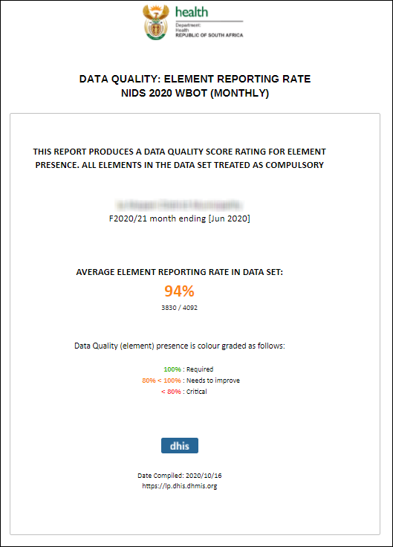
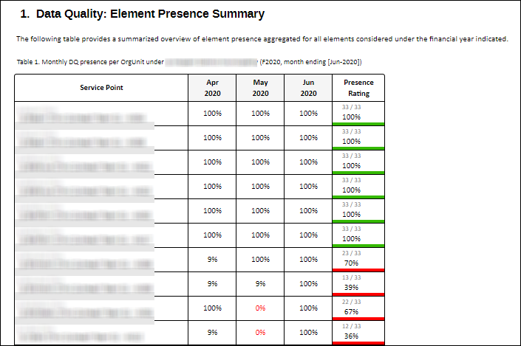
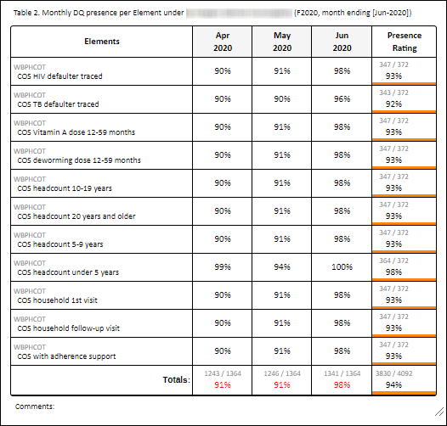
Element Reporting Rate

Slide 12
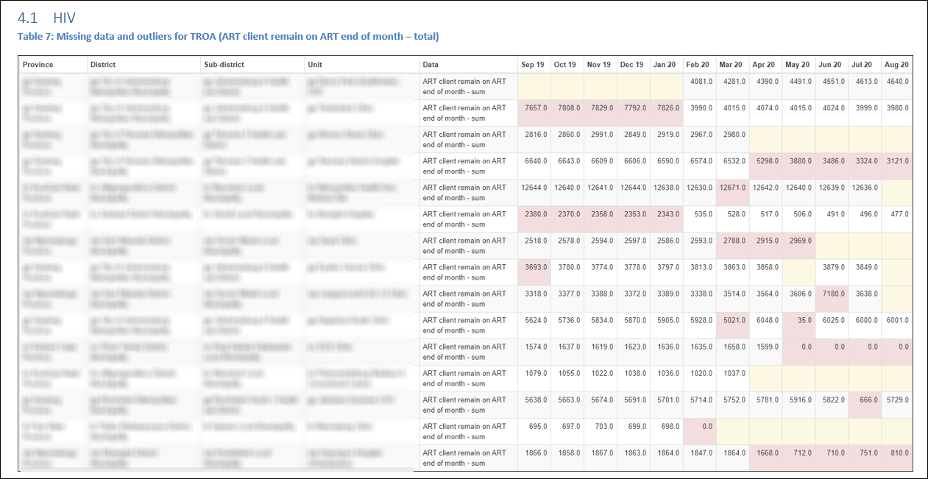
Missing Outlier Analysis

Slide 13
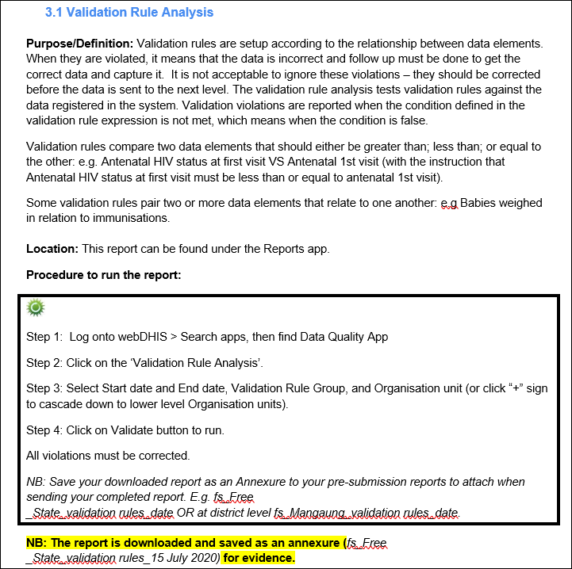
Validation Rule Violations

Slide 14

Training and guidelines
Daily data capturing online course – learner manual
Data quality module in DHIS2 Foundation course – learner manual
Guidelines
Dashboard maintenance guidelines

Slide 15
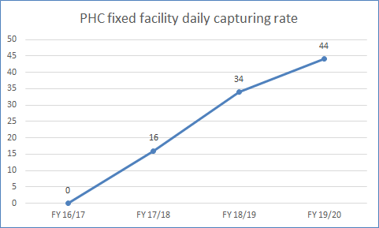
Progress with DDC

Slide 16
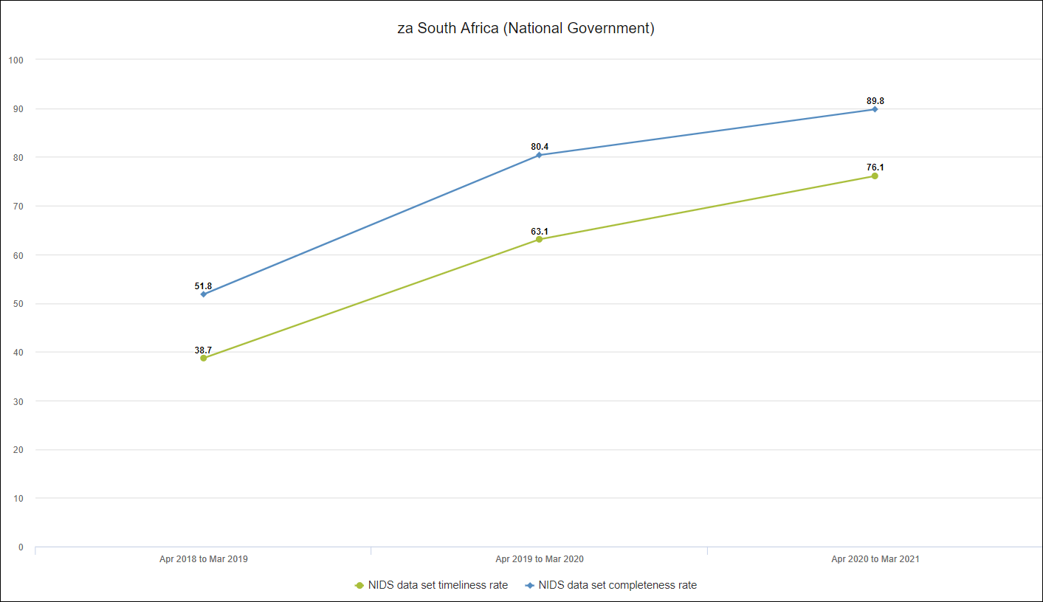
Progress with Timeliness and Completeness

Slide 17
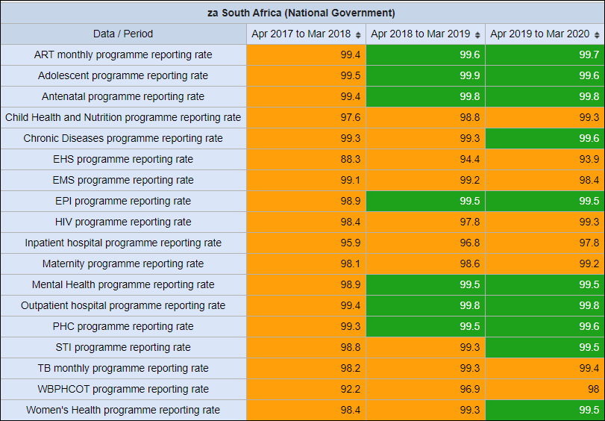
Progress with Program Reporting

Slide 18

South Africa has made considerable progress with improving data quality since the introduction of DHIS. Monthly monitoring and reporting on data quality are essential to ensure progress.

